Slide 1
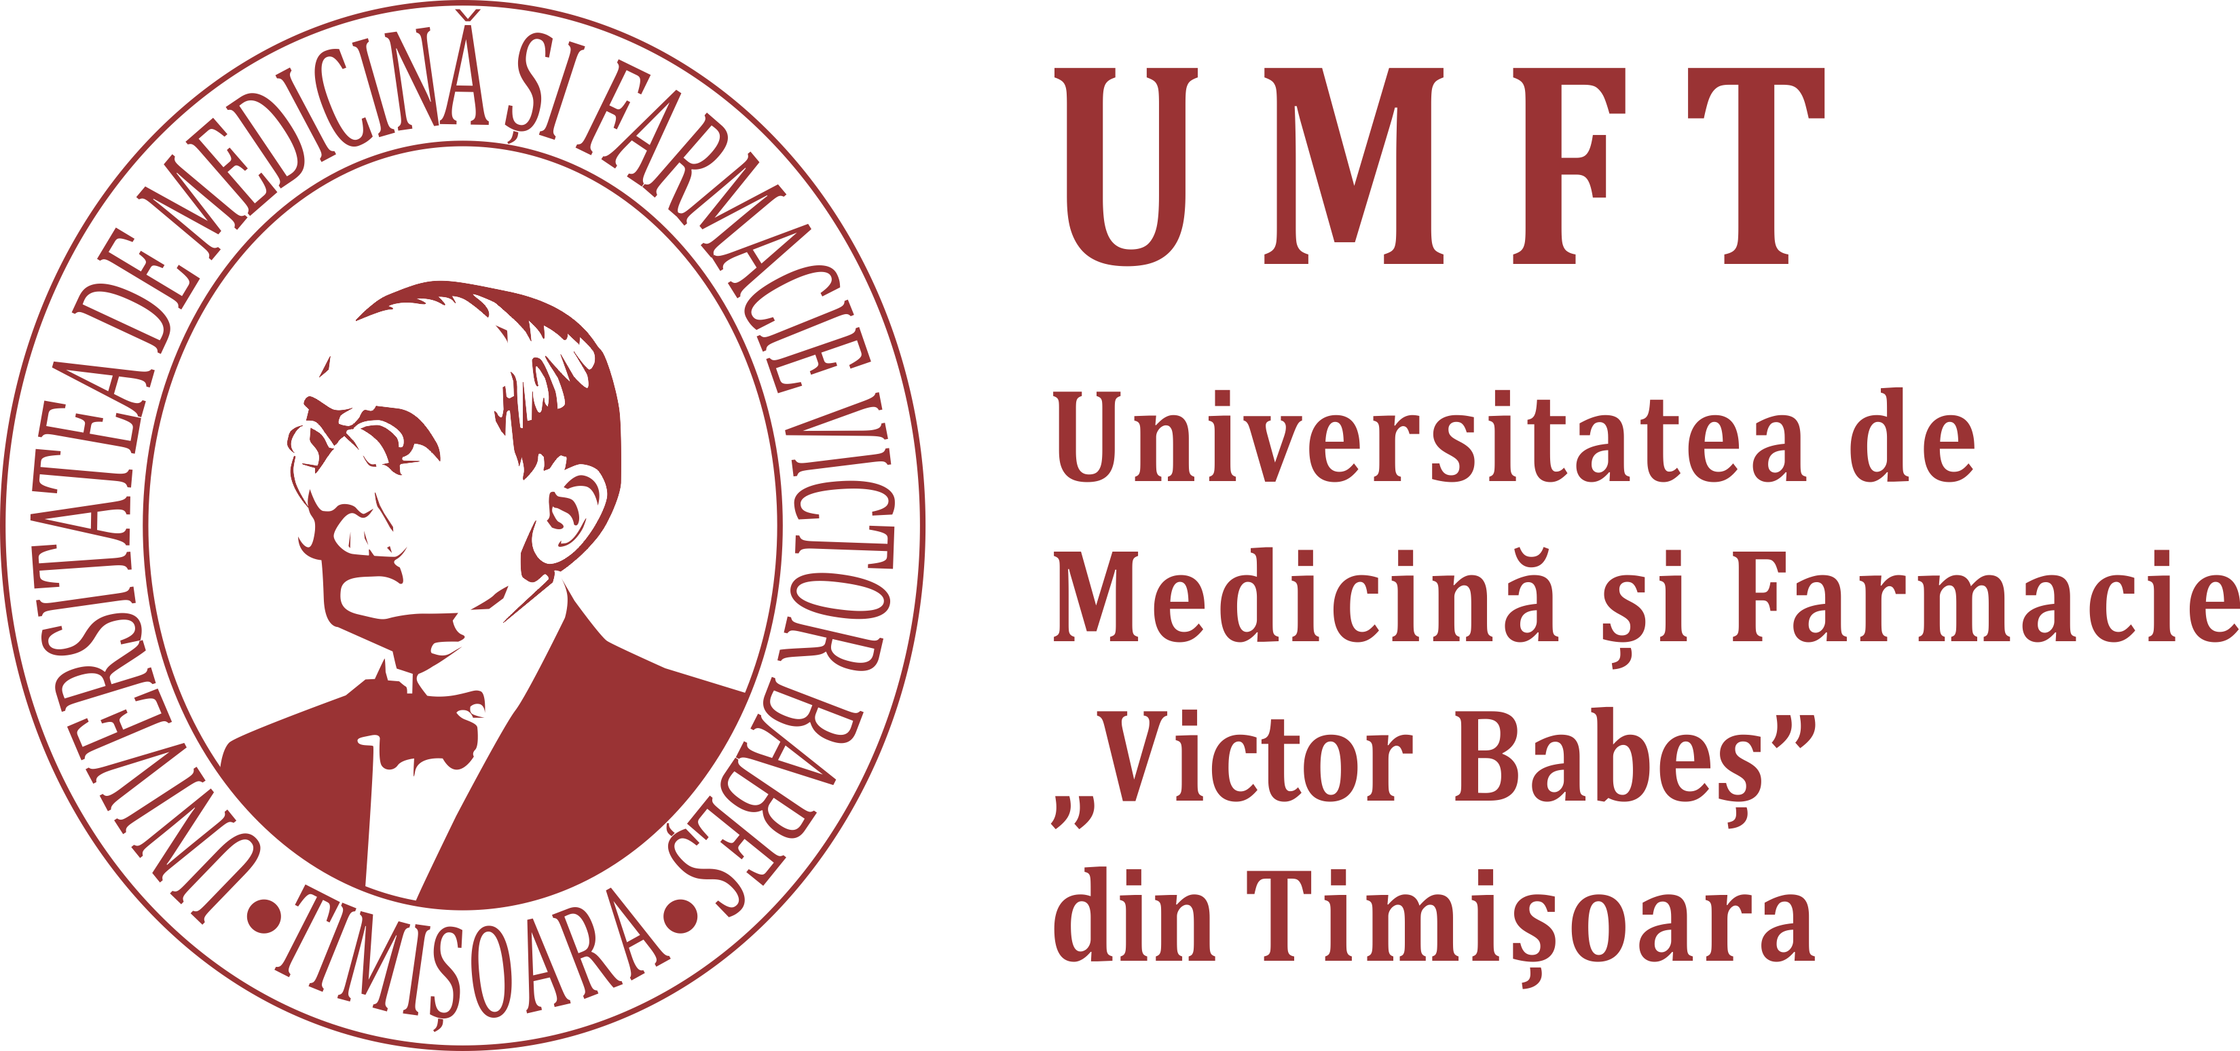

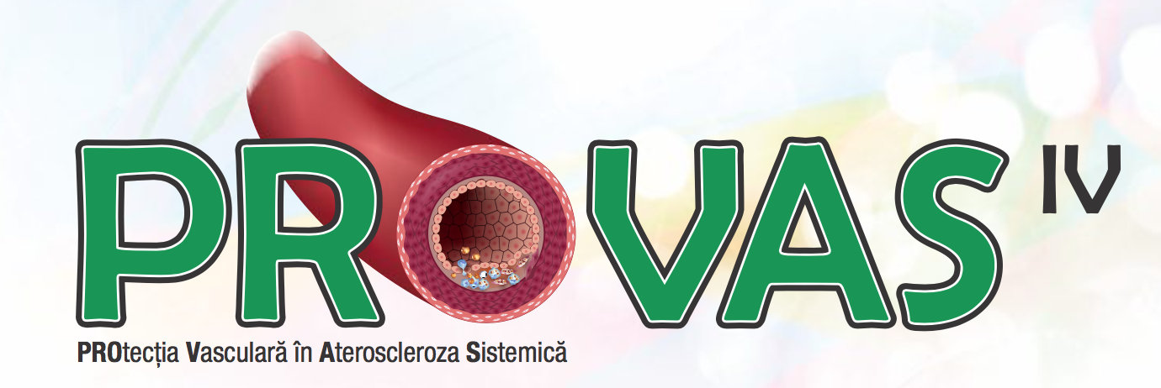
Stabilizarea placii de Aterom vulnerabile – Dincolo de LDL- colesterol
Daniel Lighezan, FESC
Universitatea de Medicina si Farmacie “Victor Babes”
Timisoara

Slide 2
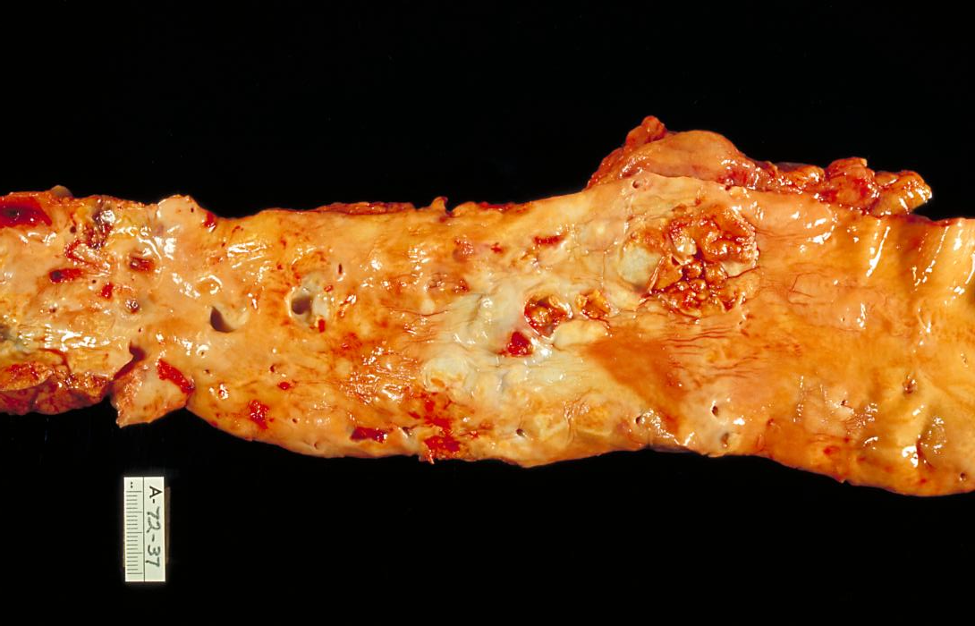
Atherosclerosis
Disease of cardiovascular system affecting vessel wall.
It leads to the narrowing of arteries or complete blockage.
Its main components are endothelial disfunction, lipid deposition, inflammatory reaction in the vascular wall.
Remodeling of vessel wall.

Slide 3
Arterial wall
In the case of intact endothelium, the stimulus for vasodilatation:
  mechanical stimulation by  blood flow
  catecholamines, bradykinin, platelets-released serotonin stimulate specific receptors
In the case of endothelium disfunction:
  direct vasoconstrictor action of the stimuli on the VSMC outweighs the endothelium-dependent vasodilatator effect
  this action leads to paradoxial vasoconstriction
  (Hypercholesterolemia and other cardiovascular risk factors are associated with endothelial disfunction).

Slide 4
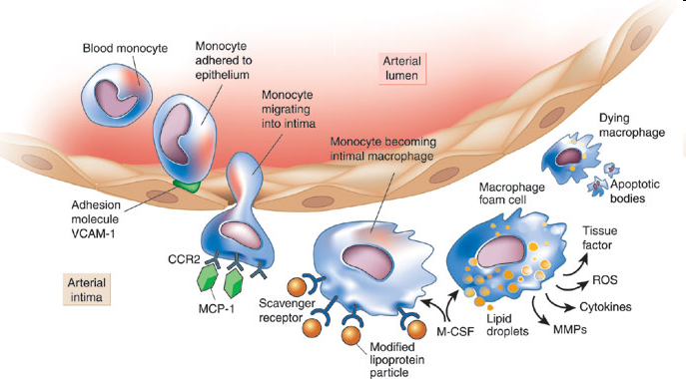
Inflammation in atherosclerosis (mononuclear cells)
Endothelial cells undergo inflammatory activation, produce different leukocyte adhesion molecules (VCAM-1). Monocytes penetrate into tunica intima. Their receptor CCR₂ interact with MCP-1
Resident monocytes acquire characteristics of tissue macrophages.
Macrophages express scavenger receptors for oxidized LDL, internalized lipoprotein particles. Macrophages change to foam cells (lipid droplets are accumulated within the cytoplasm).
Foam cells secrete pro-inflammatory cytokines.
This process amplify local inflammation and ROS.
Fom the review article: Libby P.: Inflammation in atherosclerosis. Nature 420, 2002: 868-874

Slide 5
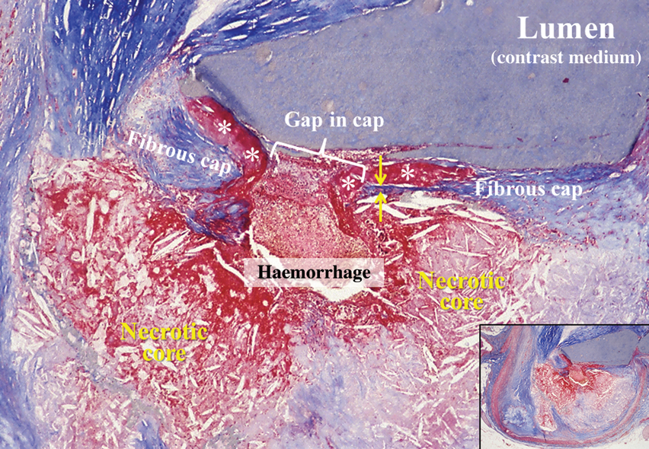
Vulnerable plaques
The majority of coronary thrombi (∼75%) is caused by plaque rupture
Prototype of the rupture-prone plaque contains a large, soft, lipid-rich necrotic core with a thin and inflamed fibrous cap, so-called thin-cap fibroatheroma (TCFA)
Other common features
  expansive remodelling
  large plaque size
  plaque haemorrhage
  Neovascularization
  adventitial inflammation
  ‘spotty’ calcifications.

Slide 6
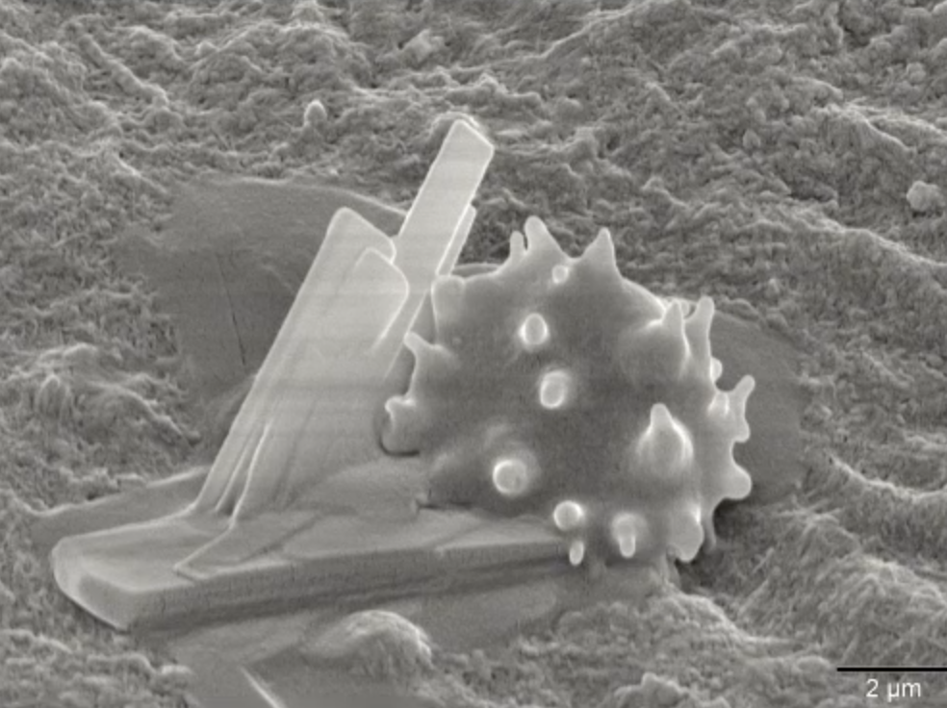
Beginning of Atherosclerosis

Slide 7
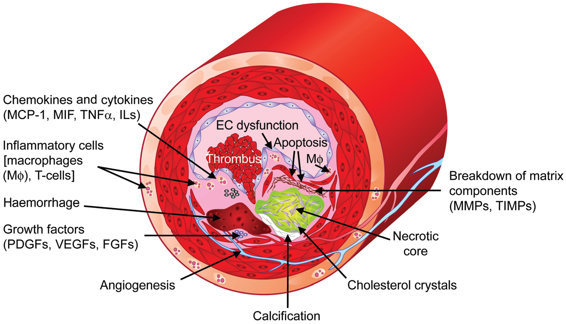
Thin-cap fibroatheroma caps are usually <65 µm thick.
No distinct morphological features have been identified for the erosion-prone plaques, but they are usually rarely associated with expansive remodelling, scarcely calcified, and contain only limited inflammation.
Factors contributing to the formation of vulnerable plaques; European Heart Journal, 2013

Slide 8
Vulnerable plaques
Vulnerable plaques contain monocytes, macrophages, and T-cells.
Of the T-cells, CD4+ T-helper (Th) cells are the most prominent.
T-cells can differentiate into a Th1 phenotype, which secretes and responds to IFN-γ or a Th2 phenotype, which secretes and responds to IL-4, IL-10, and IL-13
T-cells promote the vulnerability of plaques through their effects on macrophages.
Similarly, there are two main plaque macrophage phenotypes: pro-inflammatory M1 macrophages (IFN-γ-induced) and anti-inflammatory or regulatory M2 macrophages
Diverse leucocyte populations in atherosclerotic plaques. Depending on the context of antigen presentation including the cytokine environment, naïve T-cells and macrophages may adopt several phenotypes that are more or less inflammatory.
For an unstable phenotype, IFN-γ, IL-12, and IL-18 seem to be important factors.
Important players for plaque destabilization are macrophage migration inhibitory factor (MIF) and monocyte chemotactic protein-1.
Of the plaque-stabilizing factors, IL-10 and TGF-β are of the greatest significance.

Slide 9
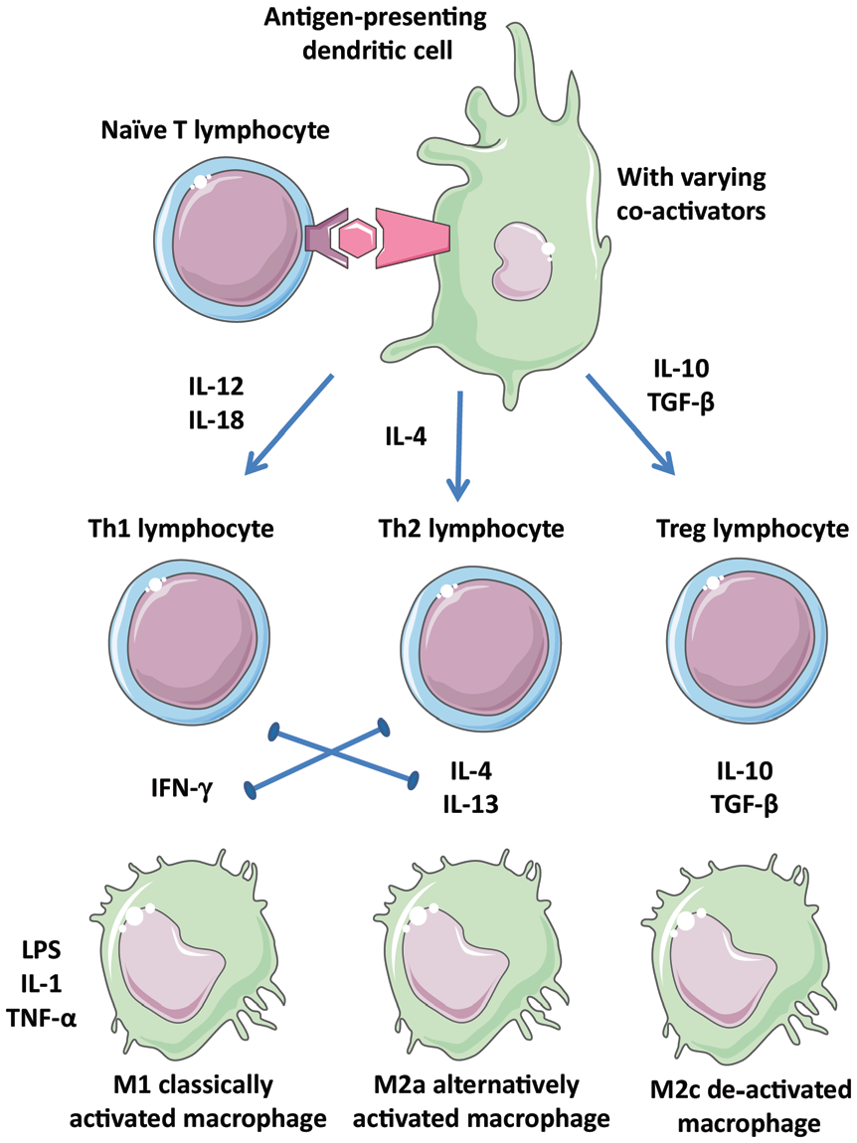
Tipuri diverse de populatii leucocitare din placile aterosclerotice M2c: macrophage subtypes
European Heart Journal, 2013

Slide 10
Vulnerable plaques
Progenitor cells
Clinical studies show correlations of endothelial progenitor cells (EPCs) with atherogenesis suggesting that EPCs may provide protection against atherosclerosis .
Recent data question these findings: putative EPCs measured in the clinics have generated mostly inflammatory cells rather than endothelial cells. Also, mouse studies tracking endothelial origin in atherogenesis have found rare, if any, contributions from the blood
Smoking
Smoking causes endothelial damages, disturbances in coagulation, and inflammation
Stopping smoching is beneficial for plaque stabilization.

Slide 11
Vulnerable plaques
Angiogenesis
Microvessels are abundant in vulnerable plaques and can contribute to plaque inflammation
Whether haemorrhage from neovessels triggers plaque rupture (or vice versa) remains to be demonstrated.
Mechanisms regulating plaque angiogenesis involve hypoxia-inducible factor and growth factors ( VEGFs, PlGF, PDGFs, and FGFs)
While VEGF is expressed in atherosclerotic lesions patients receiving anti-VEGF antibodies for cancer show increased CVD complications. This finding is compatible with vasculoprotective effect of VEGF, and transient treatment of mice with VEGF has not increased atherosclerosis
Whether therapeutic manipulation of angiogenesis can stabilize plaques remains to be investigated.

Slide 12
Detection of unstable plaques
Biomarkers and genetic testing
studies have identified approximately 160 genetic loci that are associated with CVD, MI,
and restenosis
there are no data to pinpoint specific genetic signatures to the vulnerable plaque
It seems clear that part of the gene–environment interactions are regulated by epigenetics
As chromatin alterations are reversible, epigenetic modifications are amendable to pharmacological interventions, which may provide new treatments for CVD.

Slide 13
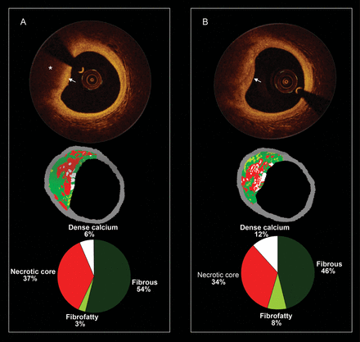
Detection of unstable plaques
Optical coherence tomography (OCT) gives a spatial resolution of ≤20 mm allowing accurate assessment of cap thickness ; has potential to assess plaque macrophage content.
NIR spectroscopy is another technique designed to identify lipid-containing plaques.
Emerging imaging techniques utilize MRI markers homing to rupture-prone plaques and markers of macrophage metabolic activity.
European Heart Journal, 2013
Notes:
Serial and corresponding virtual histology and optical coherence tomography. (A) The baseline optical coherence tomography frame (top), the corresponding virtual histology frame (mid), and the quantification of the virtual histology tissue types (bottom). The optical coherence tomography frame shows from 8 to 12 o'clock a fibroatheroma which is composed of a fibrous cap (white arrow) and a necrotic core (asterisk). The corresponding virtual histology frames show also a fibroatheroma (necrotic core-rich plaque in red colour). In (B), the patient was reimaged at 1 year and some plaque changes have been observed. In the optical coherence tomography frame, the fibrous cap became thinner (please note that at baseline, the signal rich area overlying the necrotic core was wider).

Slide 14
1992: înainte de era statinelor
“Lowering serum cholesterol concentrations does not reduce mortality and is unlikely to prevent coronary heart disease.”
Uffe Ravnskov, MD, PhD
Lund, Sweden
British Medical Journal 1992;305:15

Slide 15
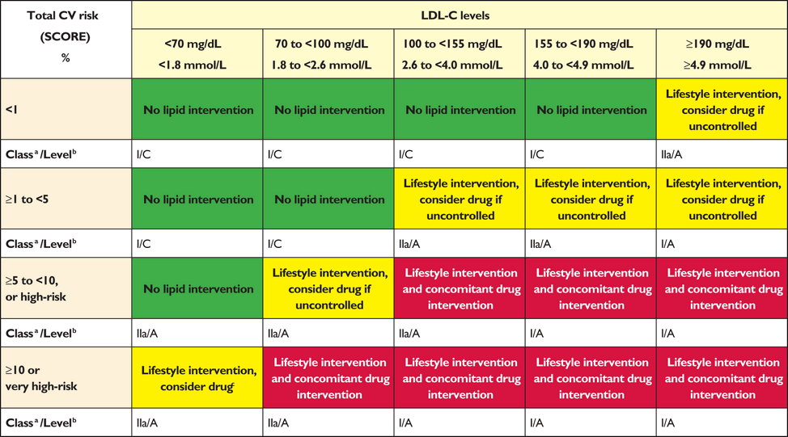
Intervention strategies as a function of total cardiovascular risk and low-density lipoprotein cholesterol level-ESC Guideline 2016

Slide 16
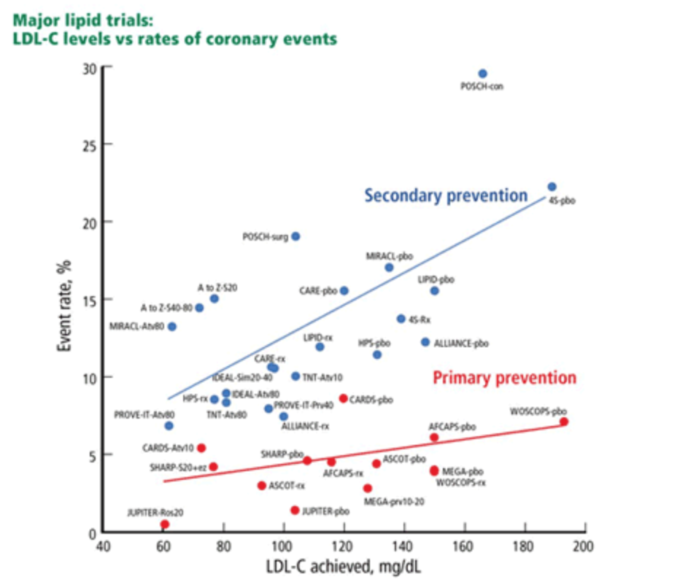
Preventia Evenimentelor Cardiovasculare majore cu statine
Raymond C , Cleveland 2014

Slide 17


Slide 18
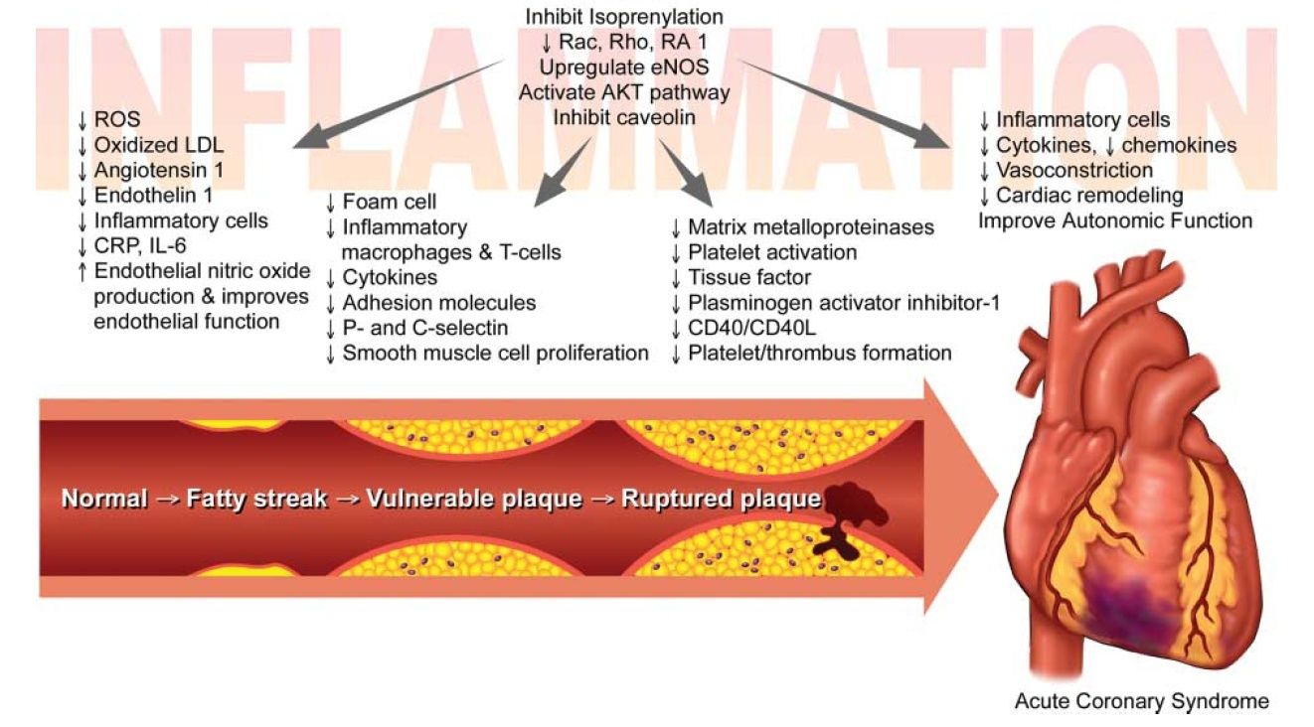
Dincolo de efectul hipolipeminat, statinele au efecte pleiotrope demonstrate
The role inflammation in the pathogenesis of coronary artery disease and ACSs. RAC and Rho, G-protein subunits; RA 1, Rap-activated 1; eNOS, endothelial nitric oxide synthase; ROS, reactive oxygen species; CRP, high-sensitivity C-reactive protein; IL-6, interleukin 6.
JACC Vol. 53, No. 23, 2009

Slide 19
Statinele îmbunătăţesc semnificativ parametri inflamaţiei şi ai funcţiei endoteliale
Atorvastatina 80 mg
Simvastatin 20 mg
60
50
*
*
*
40
†
*
†
Nivel
30
NS
*
20
10
0
Ox-LDL
NO
PCR
Fibrinogen
(U/L)
(umol/mL
(ug/dL)
(mg/dL)
Bazal
6 luni
*P<.01 vs baseline; †P<.05 vs baseline.
Ox-LDL=oxidized LDL; NO=nitric oxide; CRP=C-reactive protein.
Patients (N=97) mean age 61.2±9.7 years with previous MI were randomized to either atorvastatin 80 mg (n=47) or simvastatin 20 mg (n=50). Follow-up was 6 months. Aim: to compare intensive vs conventional lipid-lowering therapy on cholesterol levels, inflammation, and endothelial function in patients with CAD.
Hognestad A et al. Clin Cardiol. 2004;27:199-203.
Notes:
Statins have also been shown to improve measures of inflammation and endothelial function¹
This study compared the effects of intensive (atorvastatin 80 mg) vs conventional (simvastatin 20 mg) lipid-lowering therapy on cholesterol levels, inflammatory markers, and endothelial function in 97 patients with CAD after 6 months of treatment¹
Both intensive and conventional treatment regimens significantly improved LDL-C, NO, CRP, and fibrinogen levels compared with baseline levels. However, much larger changes were observed in each of these parameters following intensive treatment with atorvastatin, particularly in the case of the inflammatory marker, CRP¹
Reference: 1. Hognestad A, Aukrust P, Wergeland R, et al. Effects of conventional and aggressive statin treatment on markers of endothelial function and inflammation. Clin Cardiol. 2004;27:199-203.

Slide 20
Rosuvastatin asigură reduceri semnificative ale proteinei C reactive de înaltă sensibilitate (hsCRP) comparativ cu atorvastatin
8 săptămâni
16 săptămâni
Rosuvastatin
10 mg
Atorvastatin
10 mg
Rosuvastatin
20 mg
Atorvastatin
20 mg
N=120
N=121
N=115
N=112
Modificarea hs-CRP faţă de nivelul iniţial (%)
- 32‡
- 44*‡
- 43‡
- 52‡
*p<0,05 vs atorvastatin în acelaşi moment
‡ p< 0,001 vs iniţial
Betteridge DJ et al. Atheroscler Suppl 2005; 6: 102 Abs W16-P-007.

Slide 21
JUPITER – Evenimente tromboembolice venoase
Apariţia tromboembolismului venos în grupurile de studiu
Obiectiv Placebo Rosuvastatin HR 95% IC p
        [n=8901] [n=8901]
n (frecvenţa*) n (frecvenţa*)
Analiză primară de eficacitate, 94 cazuri
Toate cazurile de VTE 60 (0,32) 34 (0,18) 0,57 0,37-0,86 0,007
VTE neprovocat 31 (0,17) 19 (0,10) 0,61 0,35-1,09 0,09
VTE provocat 29 (0,16) 15 (0,08) 0,52 0,28-0,96 0,03
Embolism pulmonar 22 (0,12) 17 (0,09) 0,77 0,41-1,45 0,42
Tromboză venoasă 38 (0,20) 17 (0,09) 0,45 0,25-0,79 0,004
profundă
VTE neprovocat = apărut în absenţa malignităţilor, traumatismelor, spitalizărilor sau intervenţiilor chirurgicale cu 3 luni înainte de eveniment.
VTE provocat = include evenimentele apărute la pacienţi cu cancer sau în timpul / la scurt timp după traumatisme / spitalizări
*Frecvenţa este definită ca nr. de cazuri per 100 persoane-an, VTE=tromboembolism venos
HR=Hazard Ratio; IC=Interval de Confidenţă
Glynn RJ et al. NEJM 2009; 2009;360:1851-61
Notes:
Results: Venous thromboembolism (VTE) is a serious and sometimes fatal condition that is common and costly to treat. VTE includes Pulmonary Embolism (PE), which is a blood clot in the lungs, and Deep Vein Thrombosis (DVT), a clot in a deep vein, usually in the leg. There has been much discussion as to whether or not arterial and venous thrombosis share common pathways and whether treatments for one disease process also benefit the other. The effect of statins on venous thrombosis has been investigated in a number of observational studies with differing outcomes.
The JUPITER study prospectively investigated the effects of rosuvastatin on the occurrence of VTE. This analysis showed that rosuvastatin 20mg significantly reduced the risk of VTE by 43% (p =0.007) compared to placebo. Specifically, treatment with rosuvastatin 20 mg reduced the risk of DVT by 55% (p=0.004 vs placebo) and PE by 23% (p=0.42 vs placebo).
Unprovoked VTE defined as having occurred in absence of malignancy, trauma, hospitalization or surgery within 3 months before event. Provoked VTE includes events that occurred in patients with cancer or during or shortly after trauma or surgery
Reference
Glynn RJ et al. A randomised trial of rosuvastatin in the prevention of venous thromboembolism: the JUPITER trial. New England Journal of Medicine 2009; 360: (10.1056/NEJMoa0900241)

Slide 22
Plaque stabilization-statin therapy
Patients receiving pravastatin 3 months before carotid endarterectomy showed significantly less inflammation and a higher collagen content in carotid plaques,
The ATROCAP study randomized two-step bilateral carotid endatherectomy patients to atorvastatin or placebo for 4–6 months after the first procedure. Plaques from treated patients showed a trend towards fewer inflammatory cells, whereas no change was observed in controls.
The German Atorvastatin Study demonstrated that hyperechogenicity of plaques significantly increased after 12 months compared with non-statin-based lipid lowering.
In ASTEROID and SATURN studies, aggressive lipid lowering regressed atheroma volume in IVUS.
PROVE-IT trial showed lower CVD endpoints after 24 months under intense lipid lowering in ACS patients.
JUPITER study in healthy subjects with LDL ,3.4 mmol/L and hs-C-reactive protein above 2 mg/L showed that 20 mg of rosuvastatin significantly reduced major CVD events in this low-risk group.

Slide 23
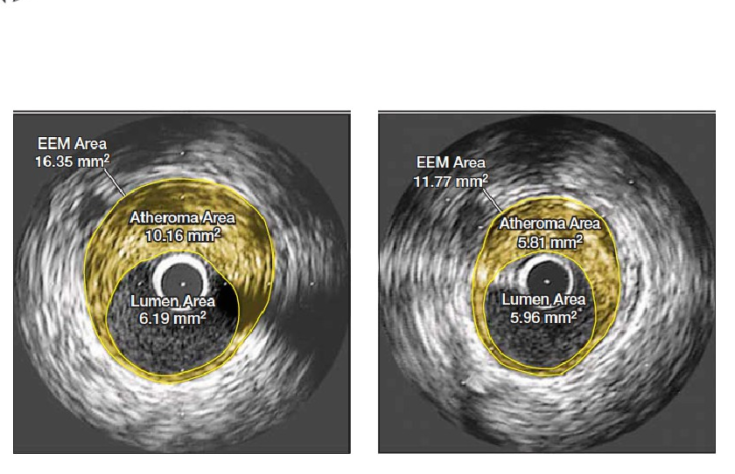
The ASTEROID Study
Interventional Cohort Study
Rosuvastatin 40mg, 349 patient, repeat scanning 2 years
Before
After 24 months Rosuvastatin
6.8% reduction in median atheroma burden
Nissen et al. J Am Med Assoc 2006;295:1556-1565

Slide 24
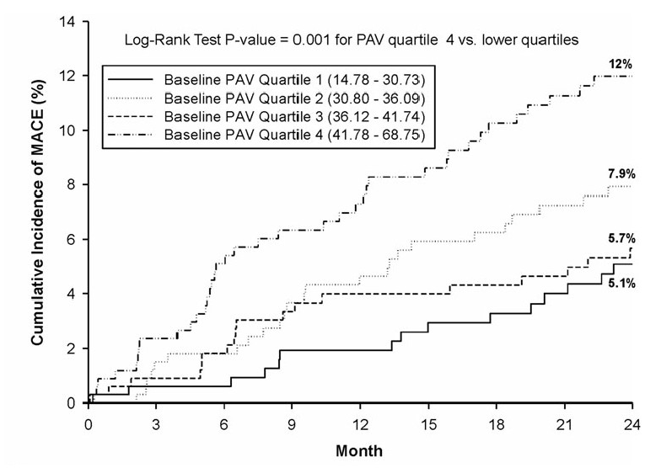
Percentage Atheroma Volume
Prediction of Clinical Events
Puri et al. Eur Heart J 2013;34:3182-3190

Slide 25
Impact of statin therapy on coronary plaque composition
META-ANALYSIS to identify prospective studies investigating the effects of statin therapy on plaque volume and its composition using VH-IVUS.
nine studies with 16 statin treatment arms and 830 participants.

Slide 26
Impact of statin therapy on coronary plaque composition
significant effect of statin therapy
  on plaque volume
  with no significant changes in lumen volume
  external elastic membrane,
  fibrous and dense calcium volumes,
  fibro-fatty and necrotic core tissue volumes remained statistically unchanged.
In other words, there may be two differential effects of statin treatment,
  on the one hand a focal increase in cap thickness
  on the other hand a global decrease in fibrous tissue.

Slide 27
Calcium density of coronary artery plaque
Coronary artery calcium (CAC), measured by computed tomography (CT), has strong predictive value for incident cardiovascular disease (CVD) events.
The standard CAC score is the Agatston, which is weighted upward for greater calcium density.
Some data suggest increased plaque calcium density may be protective for CVD.

Slide 28
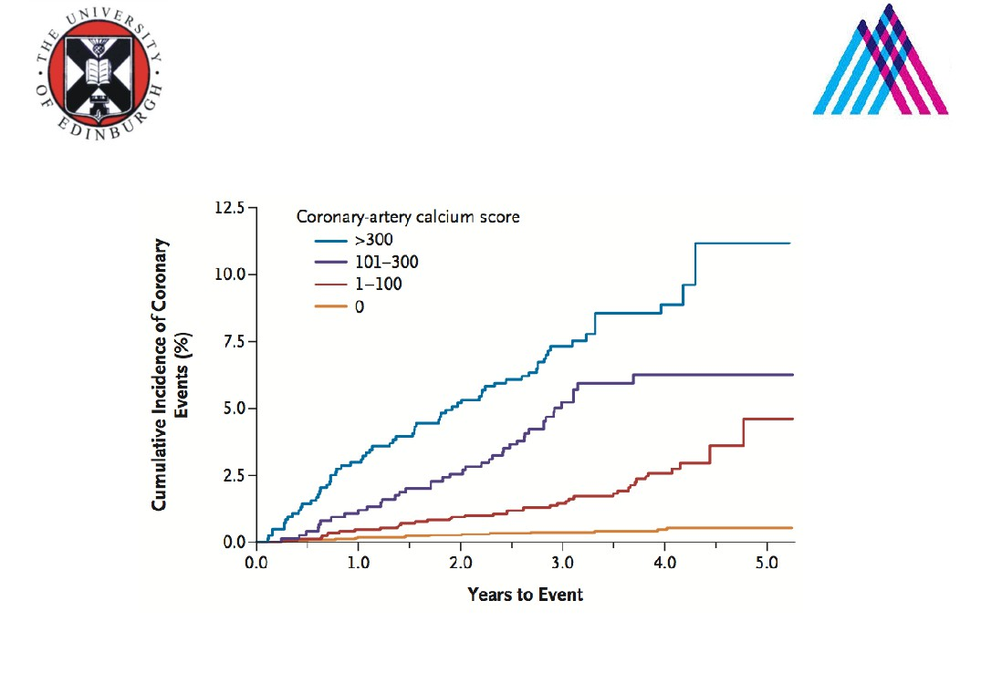
Powerful & Incremental Risk
Prediction to Risk Factors
Powerful prediction of events in all 4 racial
groups in the MESA study
Detrano R. N Engl J Med. 2008

Slide 29
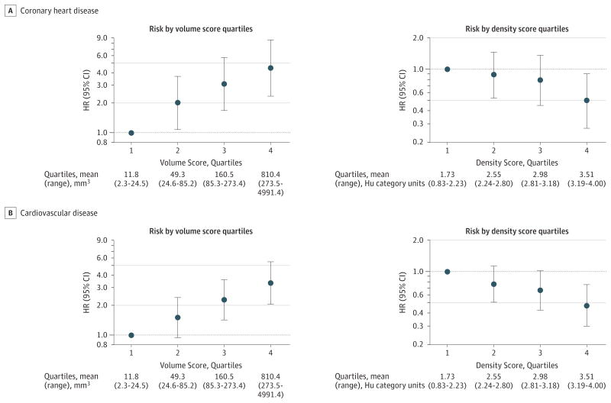
CAC Volume
CAC volume was positively and independently associated with CHD and CVD risk.
At any level of CAC volume, CAC density was inversely and significantly associated with CHD and CVD risk.
The role of CAC density should be considered when evaluating current CAC scoring systems

Slide 30
The role of coronary calcification in the atherosclerotic process and its implications on cardiovascular risk assessment.
some authors propose that calcium formation is part of the healing and stabilizing process of atherosclerosis,
Other in vitro studies indicate that calcium location may better explain the difference in plaque rupture risk
clinical studies have firmly documented a direct association between the overall calcification in coronary arteries
Motoyama et al
  demonstrated that calcium density is inversely associated with events risk.
  suggest that smaller calcium deposition (pro-inflammatory-driven microcalcifications) are associated with plaque rupture and increased cardiovascular risk,
  while larger, denser calcium structures (anti-inflammatory-driven macrocalcifications) are associated with plaque stabilization and better outcomes, in agreement with the increased dense calcification documented with statin treatment

Slide 31
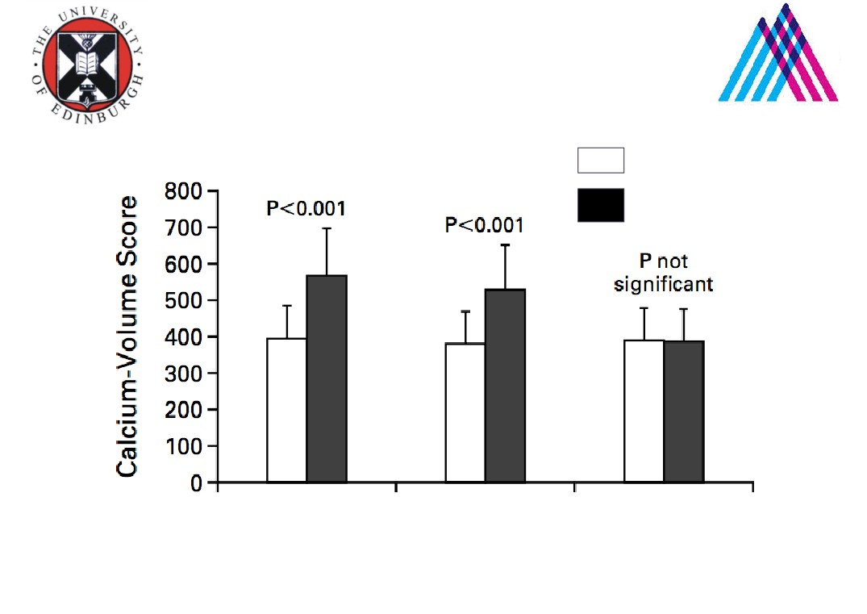
Statins and Change in
Calcium Score
= before treatment
= after treatment
No statins
Statins not to
Statins to
target
target
Retrospective study, 149 patient, repeat scanning 1 year
Callister NEJM 1998

Slide 32
Plaque rupture becomes plaque erosion
these results indicate that instead of regression, the use of statins can lead to plaque healing and stabilization.
The “healed” plaque is only discretely smaller, although it has better structure and is less prone to rupture.
Because of incomplete healing the occurrence of cardiovascular events is significant = residual risk
alter the mechanisms leading to acute coronary syndromes.
  acute coronary syndromes in those “healed” plaques are more likely to occur by erosion.
  This change is thought to be related to the improved plaque structure associated with the change in its components.

Slide 33
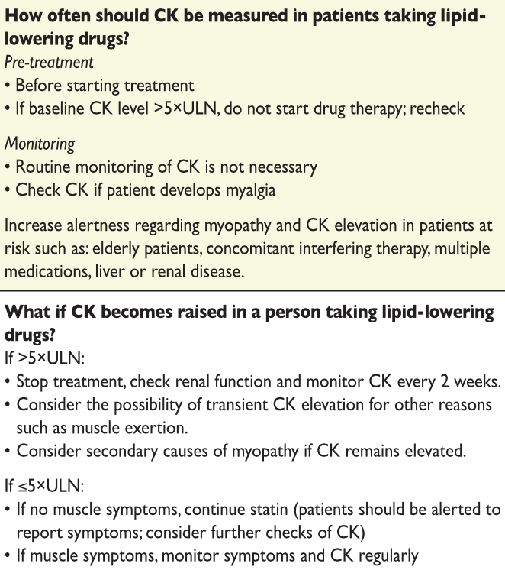
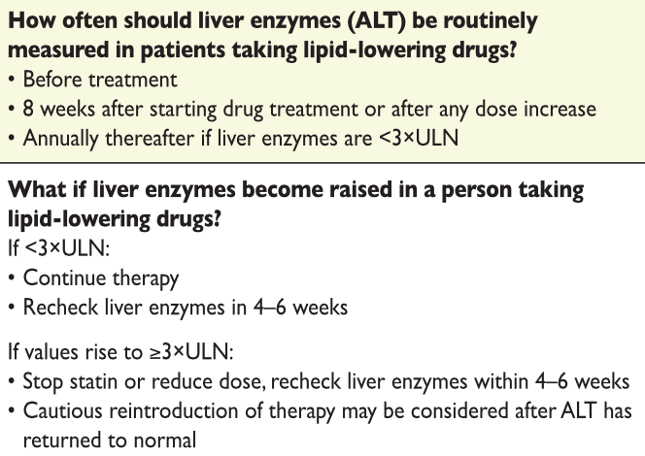
Monitoring liver and muscle enzymes

Slide 34
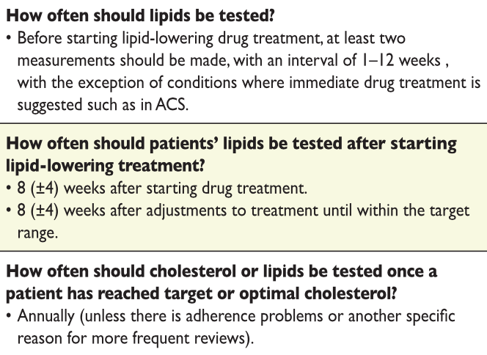
Testing Lipids

Slide 35
Plaque stabilization
Aspirin is effective for CVD secondary prevention, and a major reduction in CVD events was found in the CURE trial, where clopidogrel was added to aspirin in ACS patients. These agents mostly reduce complications of plaque rupture and may not be plaque-stabilizing agents per se. Whether new platelet inhibitors ticagrelor and prasugrel and platelet thrombin receptor inhibitor vorapaxar have plaque-stabilizing properties remains unknown although recent meta-analyses have suggested the same benefits in patients with recent ACS
Four IVUS trials have shown that b-blockers slow the progression of CVD
Endothelial function can be improved by renin–angiotensin inhibitors, and HOPE73 and ONTARGET74 trials have shown a larger reduction in CVD events that could be predicted from the reduction in blood pressure, supporting plaque-stabilizing effects.

Slide 36
Plaque stabilization
HDL-raising therapies
ApoA1-Milano and other HDL-like apoA1 complexes have been shown to regress atherosclerosis possibly via several HDL-related protective mechanisms like reverse cholesterol transport, anti-oxidative activity, endothelial vasoprotection, and reduction of platelet activation.
HDL also inhibits coagulation cascade.
Reduction in Cholesterol ester transfer protein (CETP) activity is associated with cholesterol reduction in VLDL and LDL and enrichment of HDL. However, the ILLUMINATE trial with a CETP inhibitor torcetrapib failed due to toxicity.
Trials with CETP inhibitors such as anacetrapib are underway, but dal-OUTCOMES trial assessing dalcetrapib has been stopped due to the lack of efficacy.

Slide 37
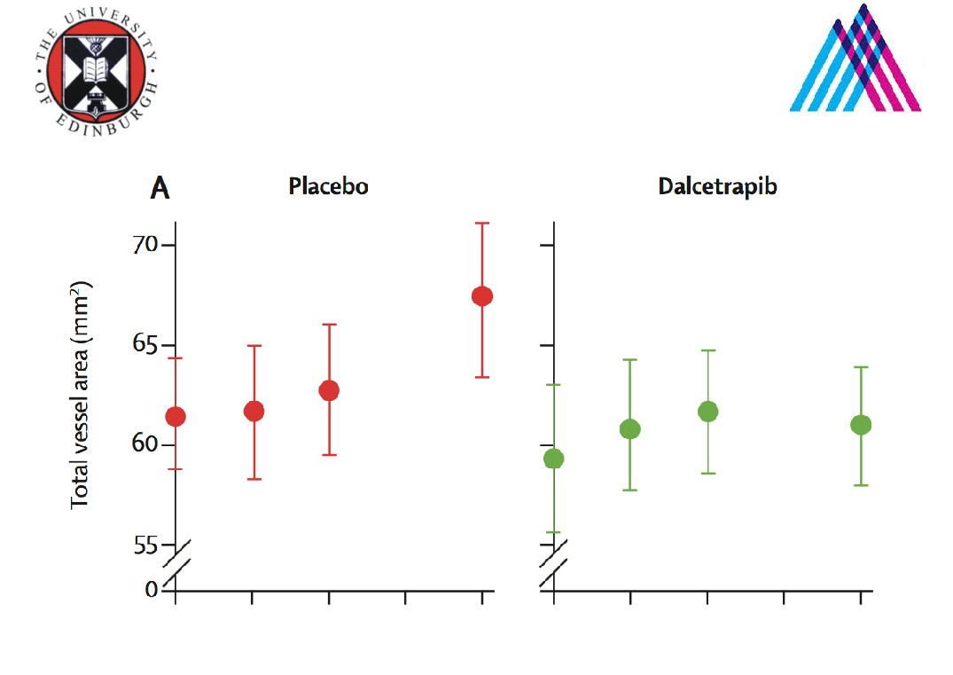
Dalcetrapib
Cholesterol Ester Transfer Protein Inhibitor
130 patients, 24 months of treatment
Fayad et al. Lancet 2011

Slide 38
Plaque stabilization-
Phospholipase inhibitors
Another approach to reduce plaque inflammation is to inhibit lipoprotein-associated phospholipase A2, which has prevented increase in necrotic core when compared with placebo.
In both STABILITY and SOLID-TIMI 52 trial -treatment with darapladib failed to positively affect any cardiovascular end point, including the individual components of the primary end point.
Antagonists against pro-atherogenic chemokine receptor CCR5 and its ligand CCL5 have been developed. Migration inhibitory factor is involved in atheroprogression and its inhibition with biologicals or small molecules may be useful for plaque stabilization.

Slide 39
Plaque stabilization- New approaches PCSK9
PCSK9 is involved in hypercholesterolaemia by favouring degradation of LDL receptor
GLAGOV is a Phase 3, multicenter, double-blind, randomised, placebo-controlled trial evaluating the impact of evolocumab on coronary atheroma volume in 968 patients with CAD receiving optimised statin therapy and undergoing coronary catheterisation. Patients were randomised to receive either monthly evolocumab 420 mg or placebo subcutaneous injections
The primary endpoint was change in percent atheroma volume (PAV) from baseline to week 78 compared to placebo, as determined by intravascular ultrasound (IVUS). Secondary endpoints included PAV regression (any reduction from baseline); change in total atheroma volume (TAV) from baseline to week 78; and regression (any reduction from baseline) in TAV.
"We are pleased with the positive results of this landmark study showing that evolocumab modifies the underlying process of atherosclerosis,"
Press release Amgen Sept 20, 2016

Slide 40
Plaque stabilization- New approaches
The ODYSSEY OUTCOMES trial is now testing the efficacy of PCSK9 inhibitor in CVD
FOURIER trial (Further Cardiovascular Outcomes Research With PCSK9 Inhibition in Subjects With Elevated Risk ) will finish up this year
siRNAs against apoB100 have been used to reduce LDL levels.
Whether this technology will be useful in the prevention of plaque ruptures remains unknown.
Immunization of hyperlipidaemic animals with LDL preparations or apoB100 fragments reduces atherosclerosis, suggesting that vaccination may become a potential strategy for the prevention of CVD.

Slide 41
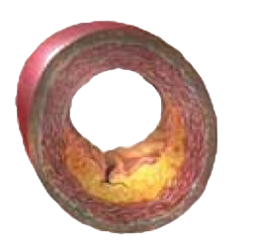
Efecte globale ale statinelor
Medicația cu cel mai puternic efect de scădere a LDL-C
cu efecte majore şi certe de scădere a morbi-mortalităţii
 Progresie placă ATS
 Funcţie endotelială
È Proliferare
Ç Bioactivitate NO
È LDL-C
È Endotelină-1
Ç HDL-C
Ç Celule progenitoare endoteliale
È Trigliceride
 Stabilitate placă ATS
 Agresiune imună
Ç Colagen
È Macrofage
È MMP
È Inflamaţie
È Imunomodulare
 Trombogenicitate
È Activare plachetară
Efect antioxidant
È Coagulare
È Receptor AT₁
È Radicali liberi
Wassmann S, Nickenig G. Endothelium 2003; 10: 23-33 (completat)
Notes:
Preclinical and clinical data suggest that statins may have a wide range of vasculoprotective effects:
Normalize vasomotion by upregulating levels of nitric oxide (NO), the most potent endogenous vasodilator, and inhibiting the synthesis of endothelin, a potent vasoconstrictor^{1,2}
Modulate immunoreactions and decrease immune injury by arresting the functional differentiation of monocytes into macrophages and promoting apoptosis; decrease inflammatory markers²⁻⁴
Decrease the production of free radicals (via a downregulation of angiotensin AT₁ receptor expression) that may enhance the proliferation of vascular smooth muscle cells and induce apoptosis⁵
Retard plaque progression by inhibiting the oxidation of LDL, VLDL, and HDL and by suppressing the uptake of oxidized LDL by macrophages¹
Promote plaque stability by decreasing the production of matrix metalloproteinases (MMPs) and increasing collagen content, thus strengthening the fibrous cap and making it less likely to rupture^{2,6}
Decrease platelet activation and increase fibrinolytic activity in endothelial cells²
References: 1. Davignon J, Ganz P. Role of endothelial dysfunction in atherosclerosis. Circulation. 2004;109(suppl III):III-27–III-32. 2. Wassmann S, Nickenig G. Interrelationship of free oxygen radicals and endothelial dysfunction—modulation by statins. Endothelium. 2003;10:23-33. 3. Vamvakopoulos JE, Green C. HMG-CoA reductase inhibition aborts functional differentiation and triggers apoptosis in cultured primary human monocytes: a potential mechanism of statin-mediated vasculoprotection. BMC Cardiovasc Disorders. 2003;3. Available at: http://www.biomedcentral.com/1471-2261/3/6. 4. Hognestad A, Aukrust P, Wergeland R, et al. Effects of conventional and aggressive statin treatment on markers of endothelial function and inflammation. Clin Cardiol. 2004;27:199-203. 5. Wassmann S, Laufs U, Bäumer AT, et al. Inhibition of geranylgeranylation reduces angiotensin II-mediated free radical production in vascular smooth muscle cells: involvement of angiotensin AT1 receptor expression and Rac1 GTPase. Mol Pharmacol. 2001;59:646-654. 6. Xu Z, Zhao S, Zhou H, et al. Atorvastatin lowers plasma matrix metalloproteinase-9 in patients with acute coronary syndrome. Clin Chem. 2004;50:750-753.

