Slide 1

Screeningul aterosclerozei subclinice – ce spun ghidurile?
D. Zdrenghea, Cluj-Napoca

Slide 2
TOATA POPULATIA TREBUIE, CEL PUTIN DE LA O ANUMITA VARSTA, INVESTIGATA PENTRU A DEPISTA ATEROSCLEROZA SUBCLINICA?

Slide 3
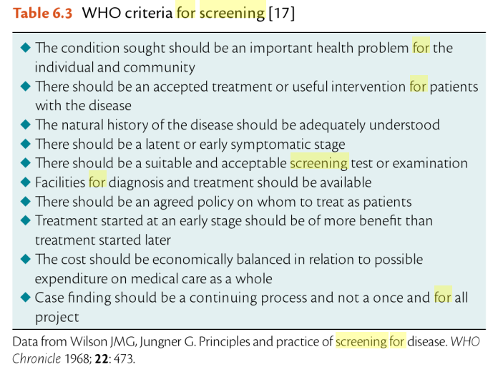
Uwe Nixdorf et al. The ESC Textbook of Preventive Cardiology, 2015

Slide 4
TOATE METODELE AU ACEEASI VALOARE IN DETECTAREA ATEROSCLEROZEI SUBCLINICE?

Slide 5
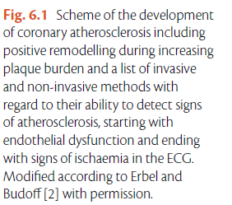
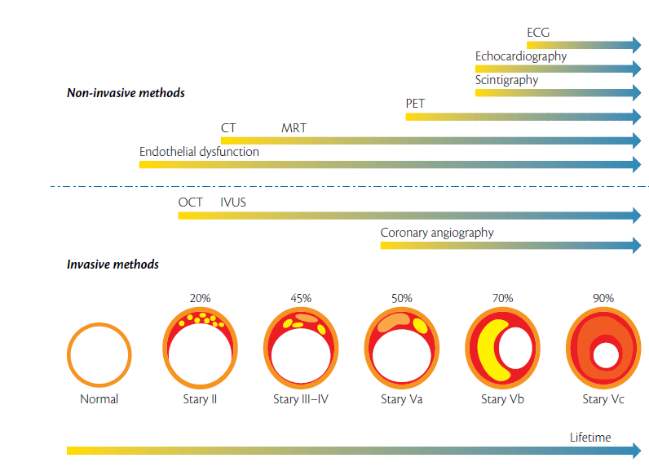
Uwe Nixdorf et al. The ESC Textbook of Preventive Cardiology, 2015

Slide 6
CARE METODE SUNT COST-EFICIENTE, SIMPLE SI POT FI LARG UTILIZATE?

Slide 7
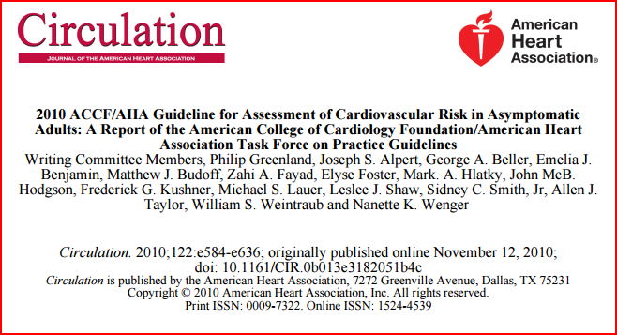

Slide 8
2.5. Cardiac and Vascular Tests for Risk Assessment in Asymptomatic Adults
2.5.1. Resting Electrocardiogram
2.5.1.1. Recommendations for Resting Electrocardiogram
Class IIa
A resting electrocardiogram (ECG) is reasonable for cardiovascular risk assessment in asymptomatic adults with hypertension or diabetes. (Level of Evidence: C)
Class IIb
A resting ECG may be considered for cardiovascular risk assessment in asymptomatic adults without hypertension or diabetes.202-204 (Level of Evidence: C)
Greenland et al. CV Risk Guideline, Circulation 2010

Slide 9
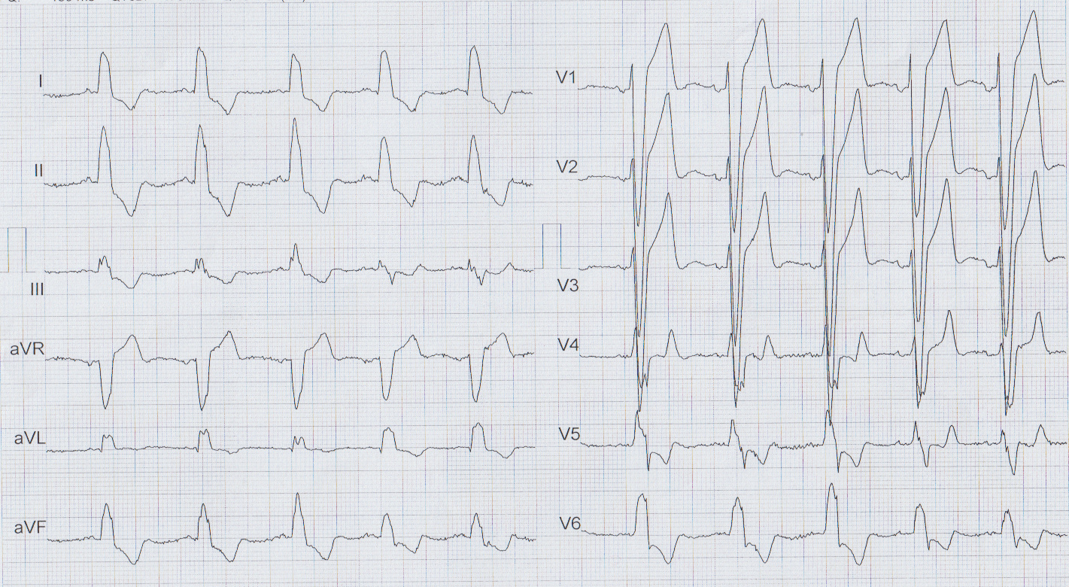
BI, 44 ani, HTA grad II, DZ tip II
Clinic: asimptomatic
EKG: ritm sinusal, 75/min, BRS major

Slide 10
2.5.2. Resting Echocardiography for Left Ventricular Structure and Function and Left Ventricular Hypertrophy: Transthoracic Echocardiography
2.5.2.1. Recommendations for Transthoracic Echocardiography
Class IIb
Echocardiography to detect LVH may be considered for cardiovascular risk assessment in asymptomatic adults with hypertension. (Level of Evidence: B)
Class III: No Benefit
Echocardiography is not recommended for cardiovascular risk assessment of CHD in asymptomatic adults without hypertension. (Level of Evidence: C)
Greenland et al. CV Risk Guideline, Circulation 2010

Slide 11
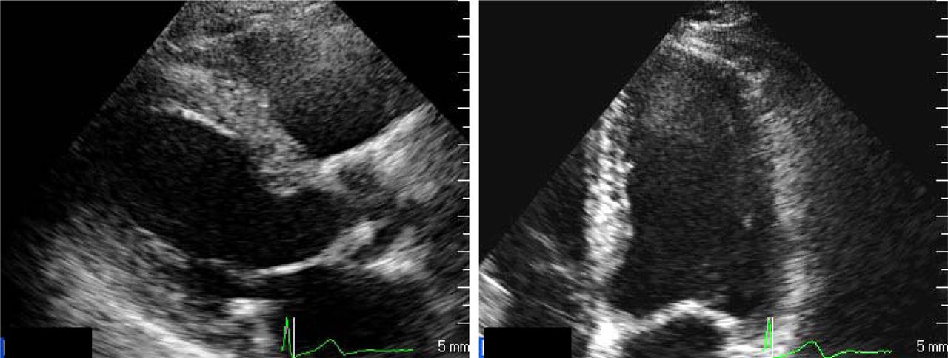
Ecografic: VS hipertrofiat concentric, SIV=14.5mm, PP=14mm

Slide 12
2.5.3. Carotid Intima-Media Thickness on Ultrasound
2.5.3.1. Recommendation for Measurement of Carotid Intima-Media Thickness
Class IIa
1. Measurement of carotid artery IMT is reasonable for cardiovascular risk assessment in asymptomatic adults at intermediate risk. Published recommendations
on required equipment, technical approach, and operator training and experience for performance of the test must be carefully followed to achieve high-quality results. (Level of Evidence: B)
Greenland et al. CV Risk Guideline, Circulation 2010

Slide 13
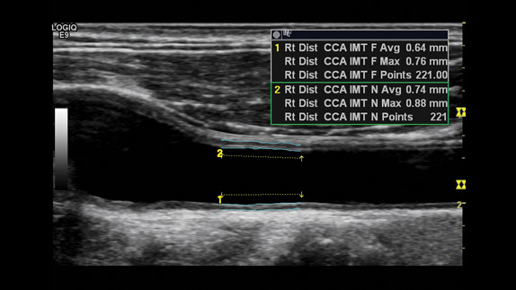
Ecodoppler carotidian – aspect normal, Grosime intima medie = 0.64, fara placi ATS

Slide 14
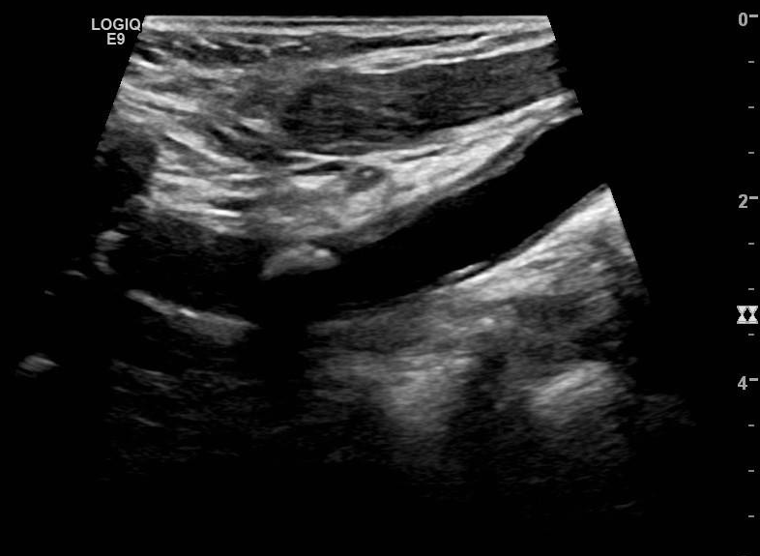
PI, barbat, 69 ani, hipertensiv, fumator, dislipidemic, cu 2 AIT in antecedente
EcoDoppler: ACC dreapta cu IMT mult crescuta si placi ATS

Slide 15
2.5.4. Brachial/Peripheral Flow-Mediated Dilation
2.5.4.1. Recommendation for Brachial/Peripheral Flow-Mediated Dilation
Class III: No Benefit
1. Peripheral arterial flow-mediated dilation (FMD) studies are not recommended for cardiovascular risk assessment in asymptomatic adults. (Level of Evidence: B)
Greenland et al. CV Risk Guideline, Circulation 2010

Slide 16
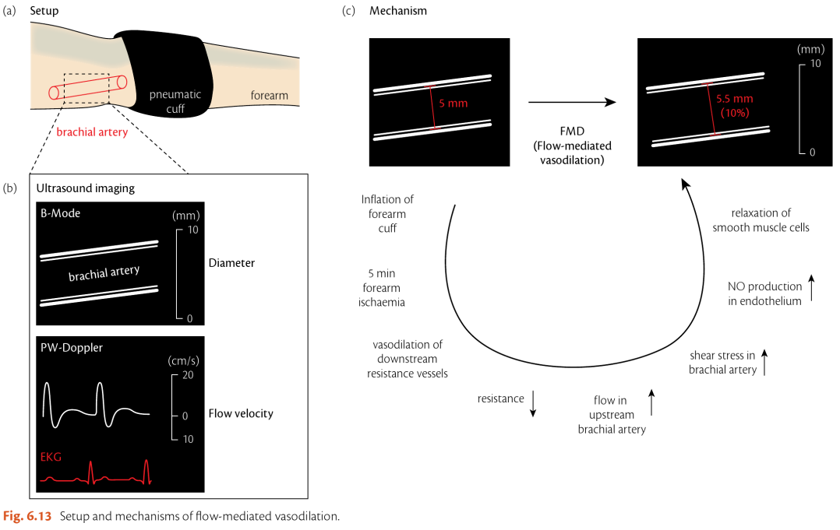

Slide 17
2.5.5. Pulse Wave Velocity and Other Arterial Abnormalities: Measures of Arterial Stiffness
2.5.5.1. Recommendation for Specific Measures of Arterial Stiffness
Class III: No Benefit
Measures of arterial stiffness outside of research settings are not recommended for cardiovascular risk assessment in asymptomatic adults. (Level of Evidence: C)
Greenland et al. CV Risk Guideline, Circulation 2010

Slide 18
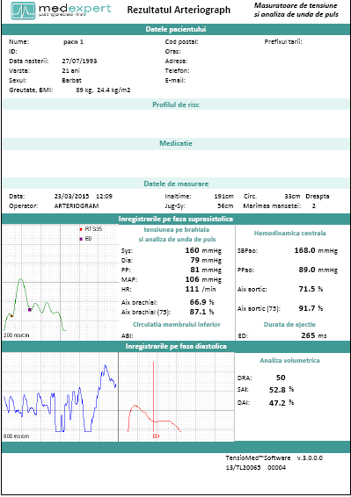
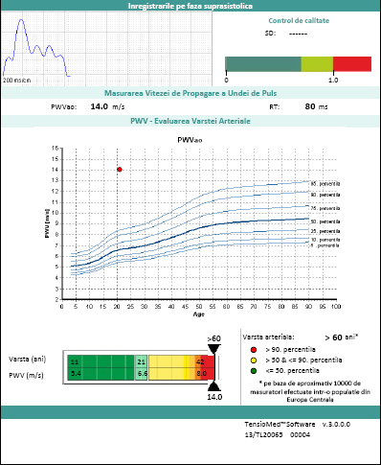

Slide 19
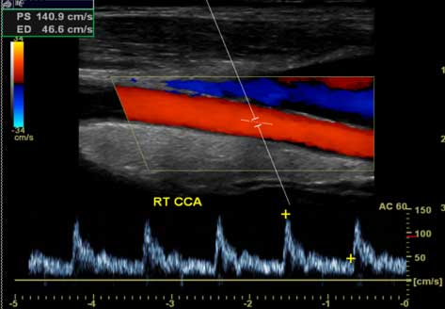
EcoDoppler carotidian – fara stenoze carotidiene

Slide 20
2.5.6. Recommendation for Measurement of Ankle-Brachial Index
Class IIa
1. Measurement of ABI is reasonable for cardiovascular risk assessment in asymptomatic adults at intermediate risk. (Level of Evidence: B)
Greenland et al. CV Risk Guideline, Circulation 2010

Slide 21
AM, barbat, 74 ani, fumator, asimptomatic
ABI la consult cardiologic de rutina preoperator pentru hernie inghinala dreapta = 0,6

Slide 22
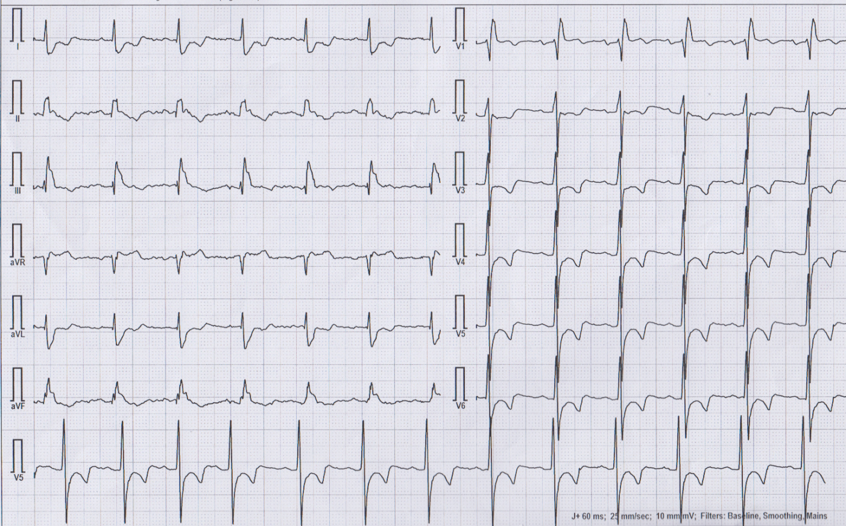

Slide 23
2.5.7. Recommendation for Exercise Electrocardiography
Class IIb
1. An exercise ECG may be considered for cardiovascular risk assessment in intermediate-risk asymptomatic adults (including sedentary adults considering starting a vigorous exercise program), particularly when attention is paid to non-ECG markers such as exercise capacity. (Level of Evidence: B)
Greenland et al. CV Risk Guideline, Circulation 2010

Slide 24
Barbat, 49 ani, supraponderal, dislipidemic, cu AHC de infarct miocardic la varsta tanara
Test de effort pozitiv pentru ischemie miocardica la 150W
Test de effort cardiopulmonar cu capacitate de efort buna (VO2 peak=27ml/min/kg)

Slide 25
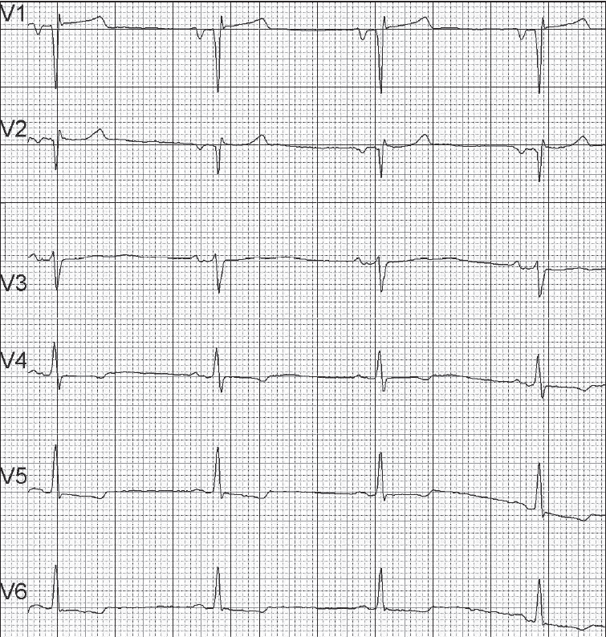
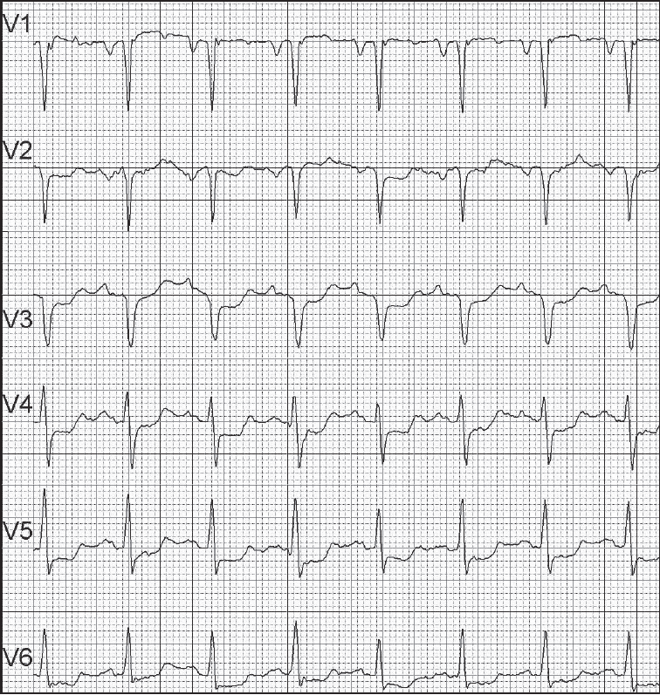
Test EKG de effort pozitiv pentru ischemie miocardica

Slide 26
Barbat, 40 ani, supraponderal,LDL 230mg/dl,fumator
Test de effort cardiopulmonar cu capacitate de efort buna (VO2 peak=27ml/min/kg)

Slide 27
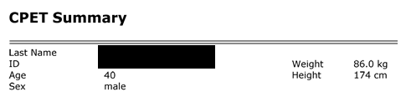
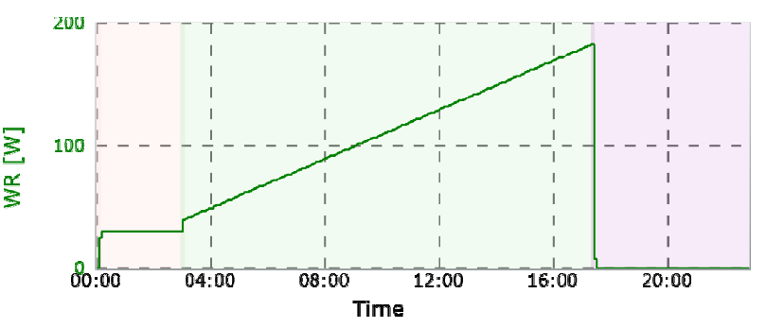
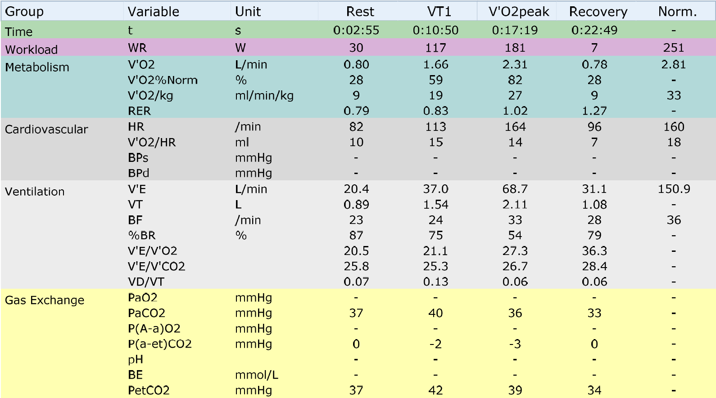

Slide 28
2.5.8. Recommendation for Stress Echocardiography
Class III: No Benefit
1. Stress echocardiography is not indicated for cardiovascular risk assessment in low- or intermediate-risk asymptomatic adults. (Exercise or pharmacologic stress echocardiography is primarily used for its role in advanced cardiac evaluation of symptoms suspected of representing CHD and/or estimation of prognosis in patients with known coronary artery disease or the assessment of patients with known or suspected valvular heart disease.) (Level of Evidence: C)
Greenland et al. CV Risk Guideline, Circulation 2010

Slide 29
2.5.9. Myocardial Perfusion Imaging
2.5.9.1. Recommendations for Myocardial Perfusion Imaging
Class IIb
1. Stress MPI may be considered for advanced cardiovascular risk assessment in asymptomatic adults with diabetes or asymptomatic adults with a strong family history of CHD or when previous risk assessment testing suggests high risk of CHD, such as a CAC score of 400 or greater. (Level of Evidence: C)
Class III: No Benefit
1. Stress MPI is not indicated for cardiovascular risk assessment in low- or intermediate-risk asymptomatic adults. (Exercise or pharmacologic stress MPI is primarily used and studied for its role in advanced cardiac evaluation of symptoms suspected of representing CHD and/or estimation of prognosis in patients with known CAD). (Level of Evidence: C)
Greenland et al. CV Risk Guideline, Circulation 2010

Slide 30
NR, barbat, 64 ani, hipertensiv, diabetic in tratament cu insulina de 5 ani
Clinic: asimptomatic
CT: calcificari coronariene, scor de calciu >400 UA
Scintigrafie miocardica de effort: defecte de perfuzie in multiple teritorii vasculare

Slide 31
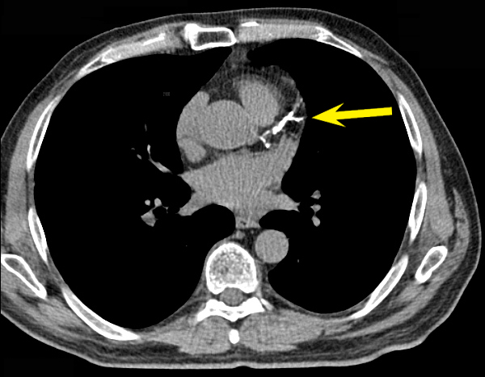

Slide 32
2.5.10. Computed Tomography for Coronary Calcium
2.5.10.1. Recommendations for Calcium Scoring Methods (see Section 2.6.1)
Class IIa
1. Measurement of CAC is reasonable for cardiovascular risk assessment in asymptomatic adults at intermediate risk (10% to 20% 10-year risk). (Level of Evidence: B)
Class IIb
1. Measurement of CAC may be reasonable for cardiovascular risk assessment in persons at low to intermediate risk (6% to 10% 10-year risk). (Level of Evidence: B)
Class III: No Benefit
1. Persons at low risk (<6% 10-year risk) should not undergo CAC measurement for cardiovascular risk assessment. (Level of Evidence: B)
Greenland et al. CV Risk Guideline, Circulation 2010

Slide 33
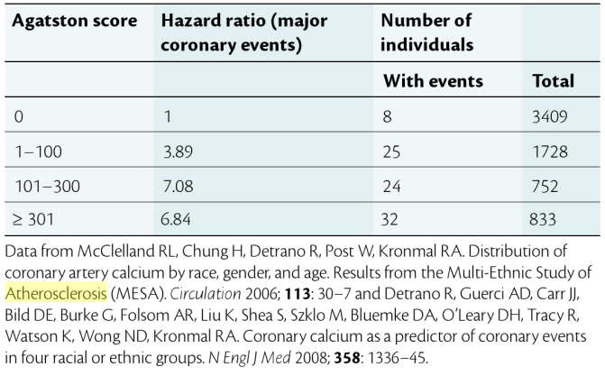
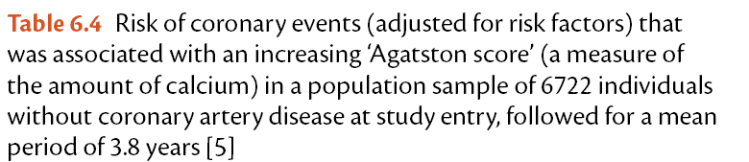
Uwe Nixdorf et al. The ESC Textbook of Preventive Cardiology, 2015

Slide 34
IR, femeie, 52 ani, hipertensiva
Clinic:asimptomatica
CT cord:- calcificari la nivelul IVA, scor de calciu = 558 UA
-Ct efectuat cu sus[piciunea leziune pulmonara
ECG subdenivelare ST semnificativa

Slide 35
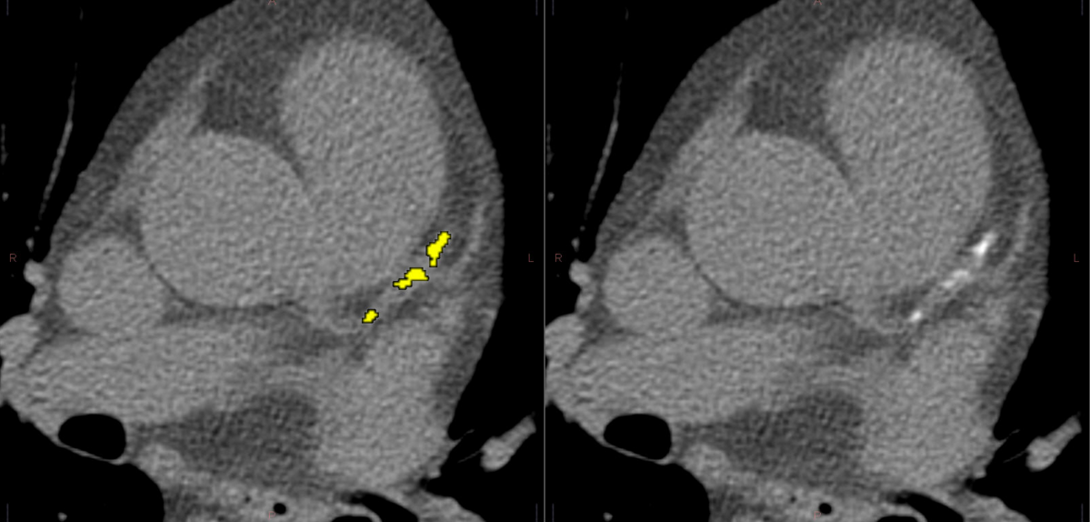
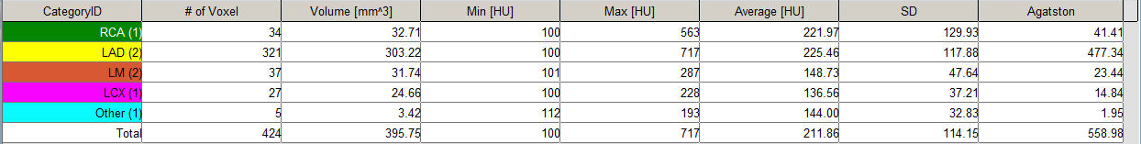
CT – calcificari IVA

Slide 36
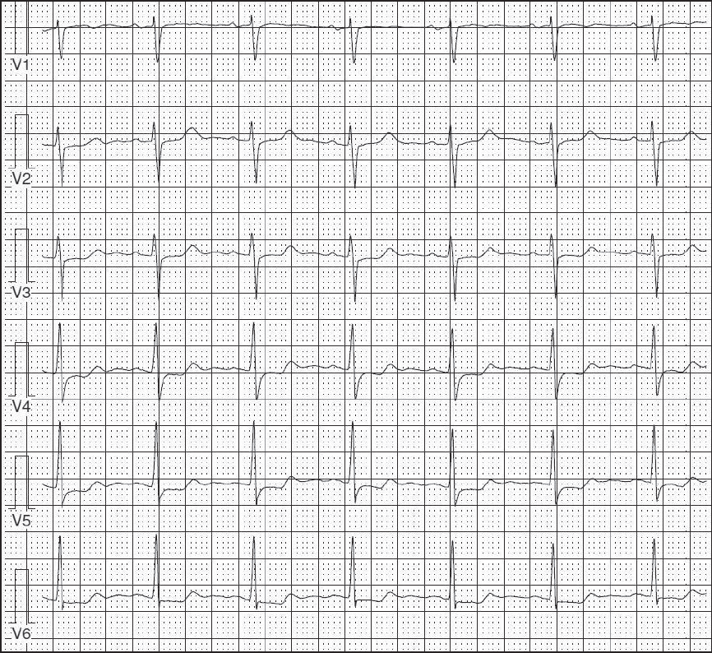

Slide 37
2.5.11. Coronary Computed Tomography Angiography
2.5.11.1. Recommendation for Coronary Computed Tomography Angiography
Class III: No Benefit
1. Coronary computed tomography angiography is not recommended for cardiovascular risk assessment in asymptomatic adults. (Level of Evidence: C)
Greenland et al. CV Risk Guideline, Circulation 2010

Slide 38
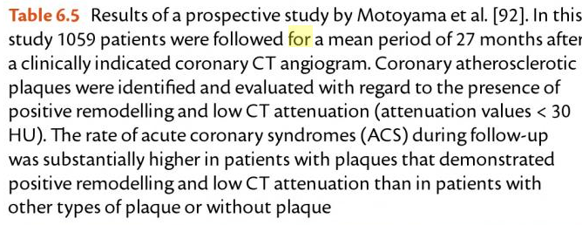
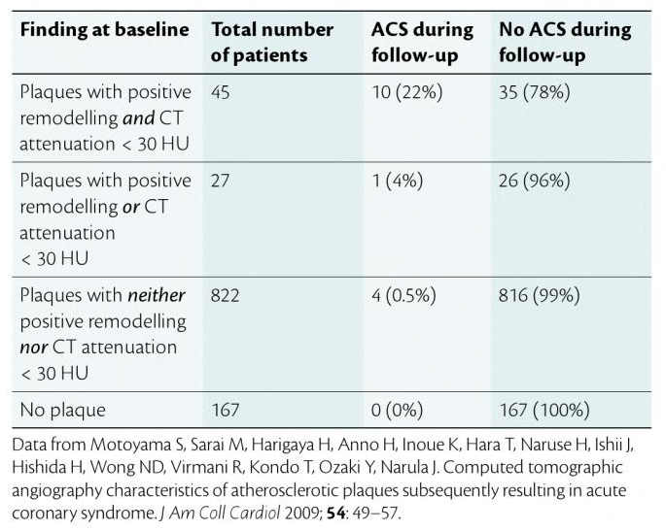
Uwe Nixdorf et al. The ESC Textbook of Preventive Cardiology, 2015

Slide 39
2.5.12. Magnetic Resonance Imaging of Plaque
2.5.12.1. Recommendation for Magnetic Resonance Imaging of Plaque
Class III: No Benefit
1. MRI for detection of vascular plaque is not recommended for cardiovascular risk assessment in asymptomatic adults. (Level of Evidence: C)
Greenland et al. CV Risk Guideline, Circulation 2010

Slide 40
2.6. Special Circumstances and Other Considerations
2.6.1. Diabetes Mellitus
2.6.1.1. Recommendations for Patients With Diabetes
Class IIa
1. In asymptomatic adults with diabetes, 40 years of age and older, measurement of CAC is reasonable for cardiovascular risk assessment. (Level of Evidence: B)
Class IIb
1. Measurement of HbA1C may be considered for cardiovascular risk assessment in asymptomatic adults with diabetes.400 (Level of Evidence: B)
2. Stress MPI may be considered for advanced cardiovascular risk assessment in symptomatic adults with diabetes or when previous risk assessment testing suggests a high risk of CHD, such as a CAC score of 400 or greater. (Level of Evidence: C)
Greenland et al. CV Risk Guideline, Circulation 2010

Slide 41
2.6.2.1. Recommendations for Special Considerations in Women
Class I
A global risk score should be obtained in all asymptomatic women. (Level of Evidence: B)
2. Family history of CVD should be obtained for cardiovascular risk assessment in all asymptomatic women. (Level of Evidence: B)
Greenland et al. CV Risk Guideline, Circulation 2010

Slide 42
RECOMANDARILE EUROPENE

Slide 43
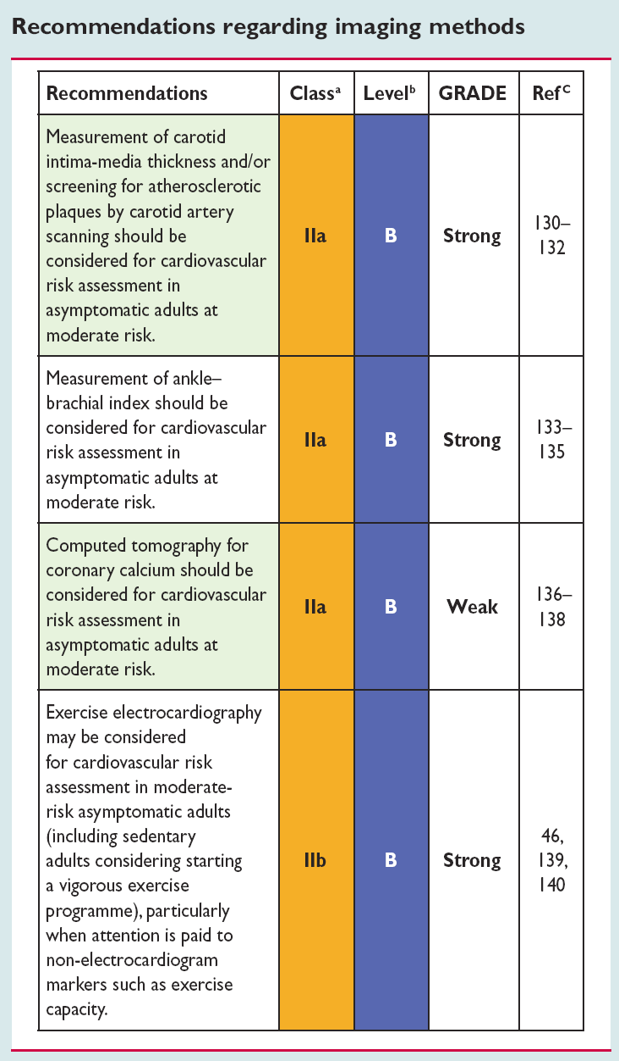
European Guidelines on cardiovascular disease prevention in clinical practice. European Heart Journal (2012)

Slide 44
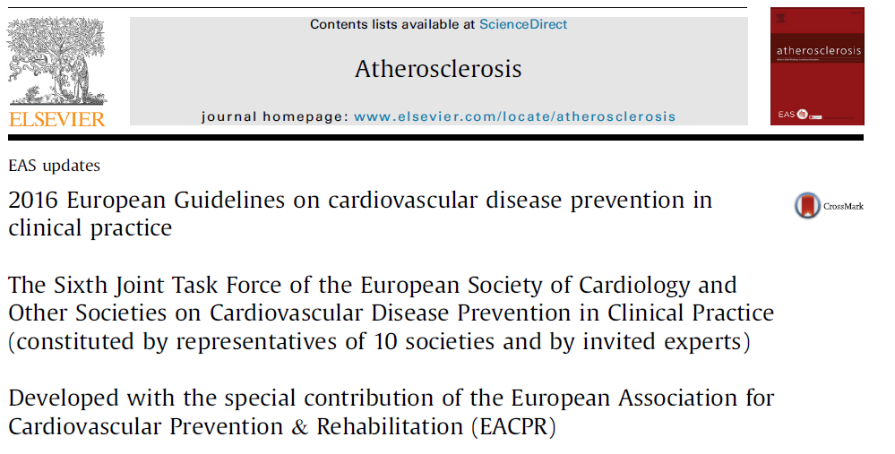
MF Piepoli et al. Joint ESC Guidelines / Atherosclerosis 252 (2016) 207e274

Slide 45
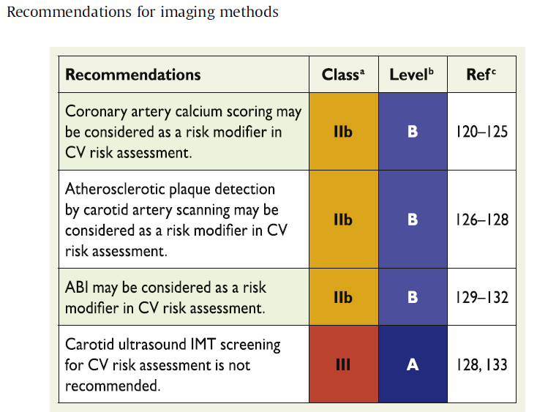
2.4.4. Measurement of preclinical vascular damage
MF Piepoli et al. Joint ESC Guidelines / Atherosclerosis 252 (2016) 207e274

Slide 46
2.4.4. Measurement of preclinical vascular damage
Key messages
Routine screening with imaging modalities to predict future CV events is generally not recommended in clinical practice.
Imaging methods may be considered as risk modifiers in CV risk assessment, i.e. in individuals with calculated CV risks based on the major conventional risk factors around the decisional thresholds.
Gaps in evidence
Currently, most imaging techniques have not been rigorously
tested as screening tools in CV risk assessment; more evidence
on calibration, reclassification and cost-effectiveness is still
needed.
The reduction of CVD risk in patients treated with lipid- or BP lowering drugs because of reclassification with, for example, CAC or ABI remains to be demonstrated
MF Piepoli et al. Joint ESC Guidelines / Atherosclerosis 252 (2016) 207e274

Slide 47
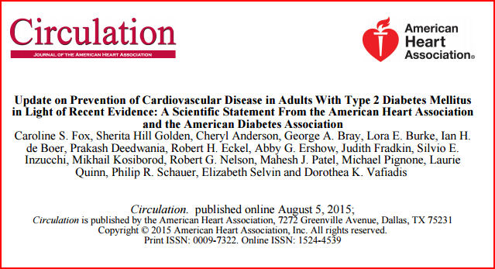

Slide 48
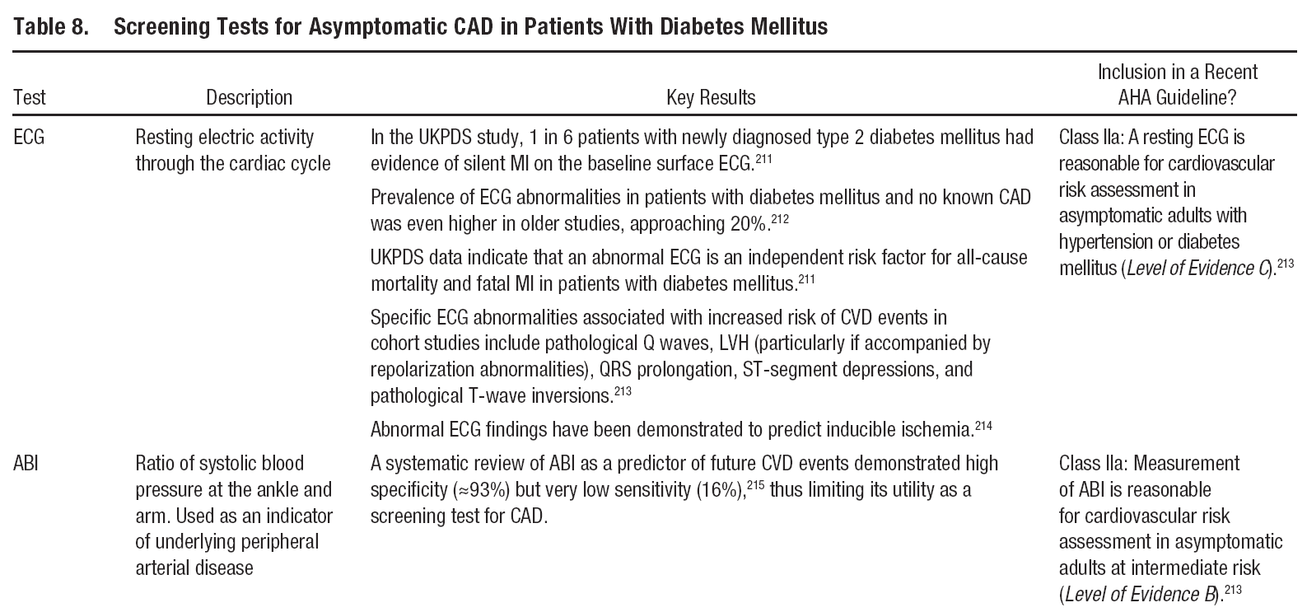
Fox et al CVD Prevention in Adults With Type 2 Diabetes Mellitus. Circulation 2015

Slide 49
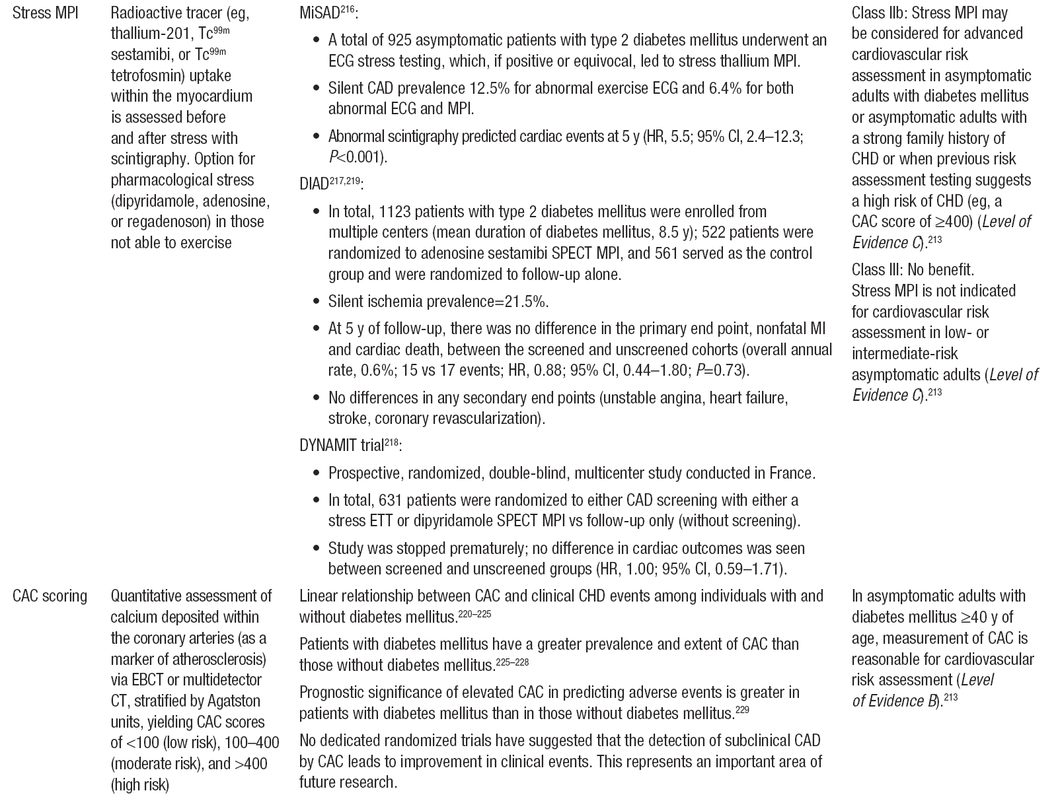
Table 8. Screening Tests for Asymptomatic CAD in Patients With Diabetes Mellitus
Fox et al CVD Prevention in Adults With Type 2 Diabetes Mellitus. Circulation 2015

Slide 50
Concluzie
PANA LA ORA ACTUALA S-AU VALIDAT PENTRU PRACTICA MEDICALA ECG DE REPAUS, IN ANUMITE SITUATII, SI DE EFFORT(TE), ABI, IMT, CT TORACIC CU SCOR DE CALCIU, EVENTUAL IN ANUMITE SITUATII SI IN SPECIAL LA DIABETICI, SCINTIGRAFIA MIOCARDICA DE STRES.
RESTUL METODELOR DE DEPISTARE A ATEROSCLEROZEI SUBCLINICE SE VOR UTILIZA DOAR IN SITUATII SPECIALE LA INDICATIA CARDIOLOGULUI.

